Slide 1
RP-X0PA_Meeting_03
Capstone project update meeting
31/05/22

Slide 2
Scope
Level 1: Rules-based recommender
Have a JD template for each Job Title
Label each role or requirements by skills / Fill-in-the-blanks methods
Show relevant role or requirement when skill is input by recruiter
Level 2: Multi-Class Classifier
Have a JD template for each Job Title
Label each role or requirements by skills using a supervised learning model
Show relevant role or requirement when skill is input by recruiter

Slide 3
Scope
Level 3: Multi-Class Classifier, Multiple Features
Have a JD template for each Job Title
Label each role or requirements by skills using a supervised learning model
Recruiters can provide other inputs such as work experience, education, industry, job level etc.
Level 4: Generative Model
Model able to generate JD without using a template / hybrid
Text generated will be based on user inputs such as Job Title, Industry, Job Level, Skills etc.
You are encouraged to try at least Level 2 for ML and NLP-related experience.

Slide 4
Requirements from last week
Narrow down to a fixed list of job titles
Find a way to group similar sentences together (Remove stopwords, keyword extraction, vectorization etc.)
Group and rank the similar sentences based on counts
Recommend the highest count sentences by job title

Slide 5
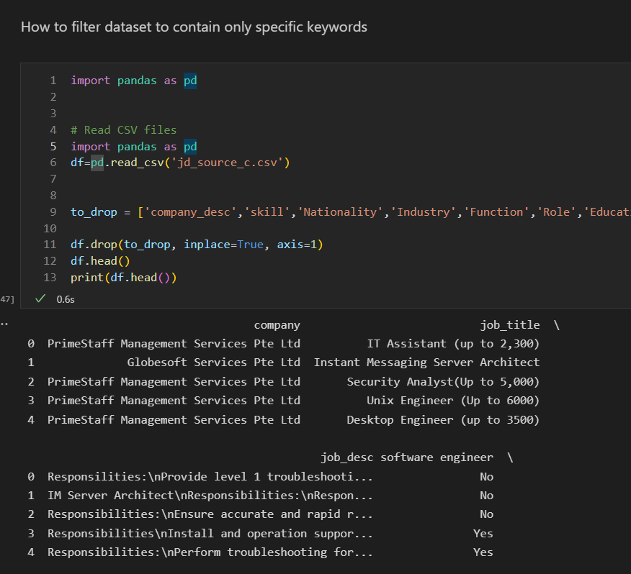
1)Narrow down to a fixed list of job titles
WE MANAGED TO NARROW DOWN A FIXED LIST OF JOB TITLES.
-Dropped the columns that are not needed
-Select specific Job descriptions
(Software Engineer, Project Engineer)
-Clean the data (In progress)

Slide 6
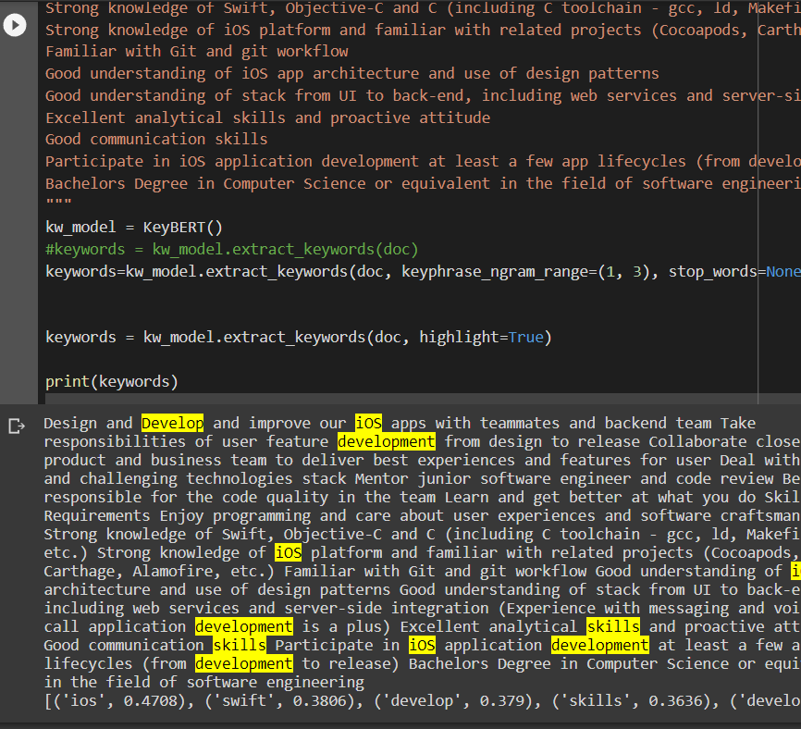
2) Find a way to group similar sentences together
We explored a few ways to group similar sentence together from the Job description
Tokenization
Spacey, counter to get most common
KeyBERT
NLTK summarization
Sklearn
(Cosine similarity between 2 JDs)

Slide 7
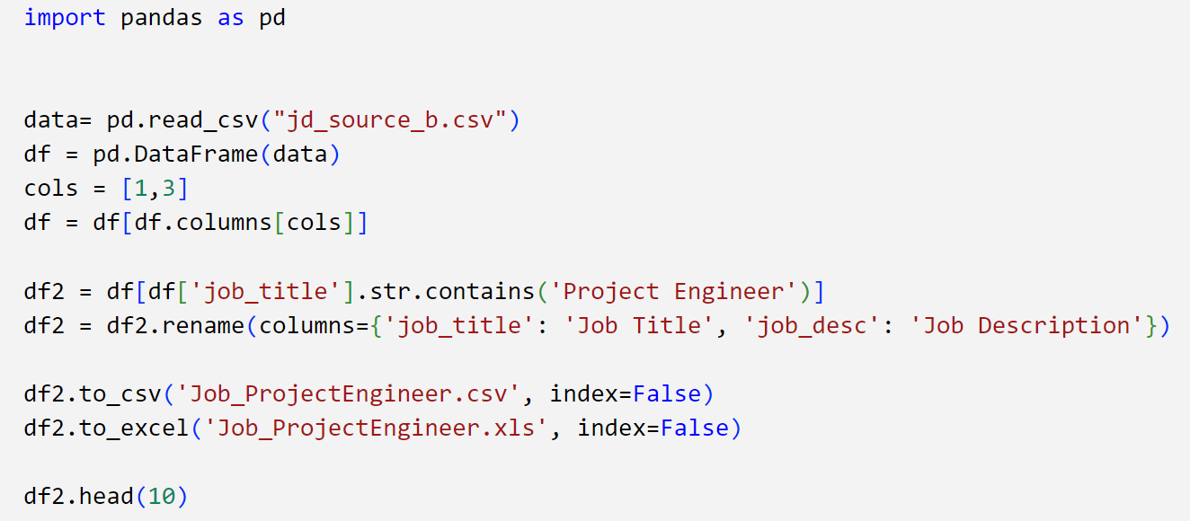
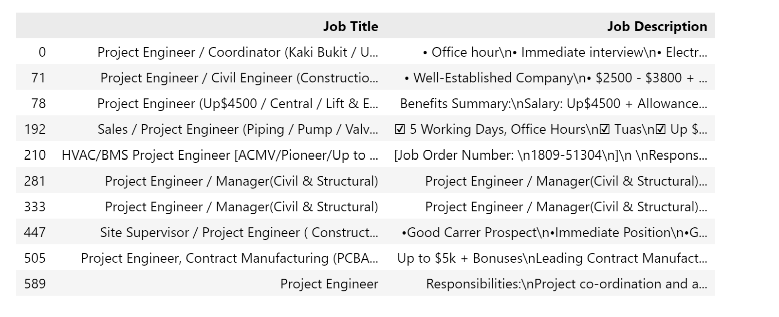
Data from jd_source_b.csv

Slide 8
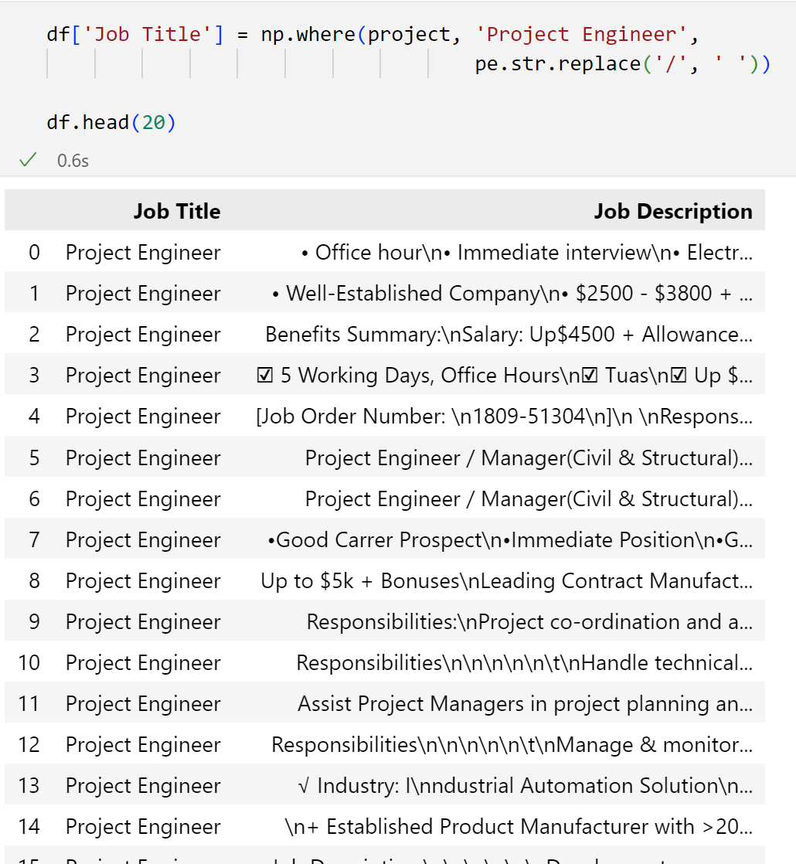
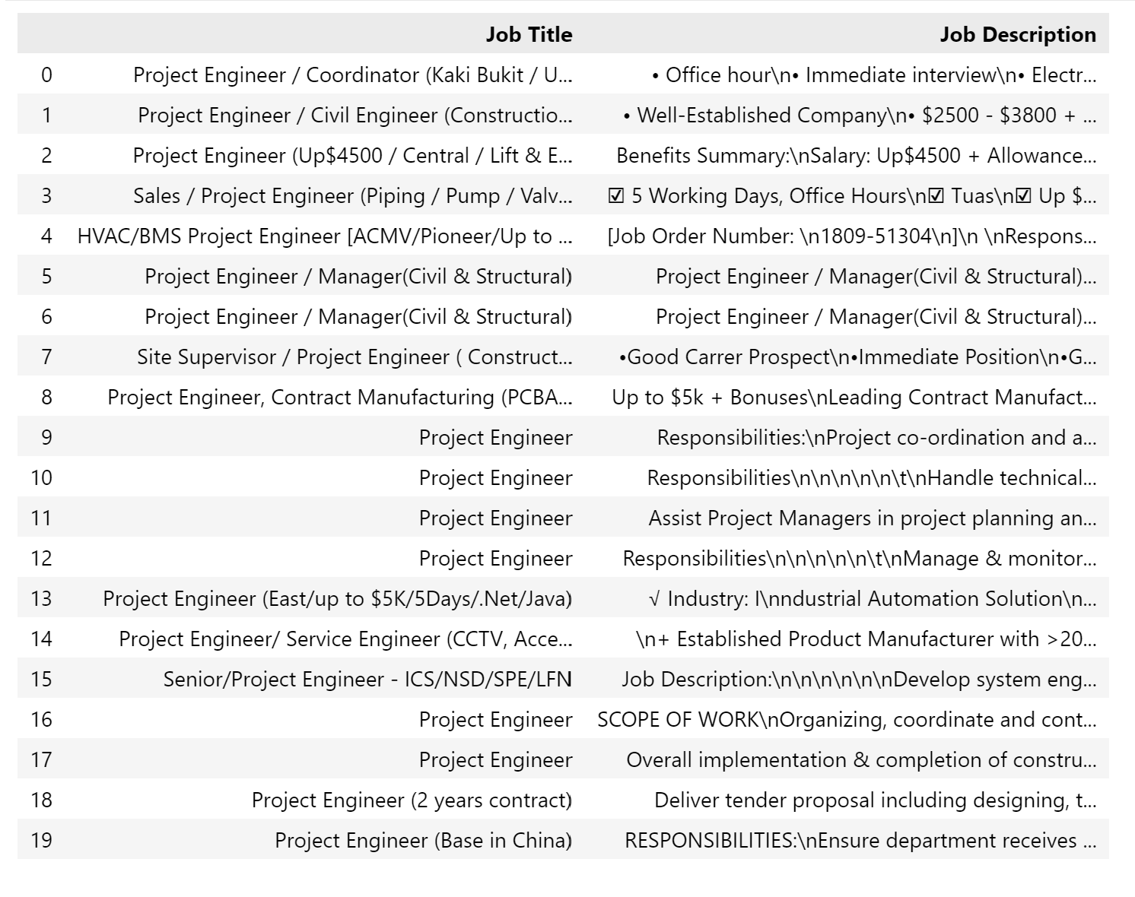
Converting to a single job title

Slide 9
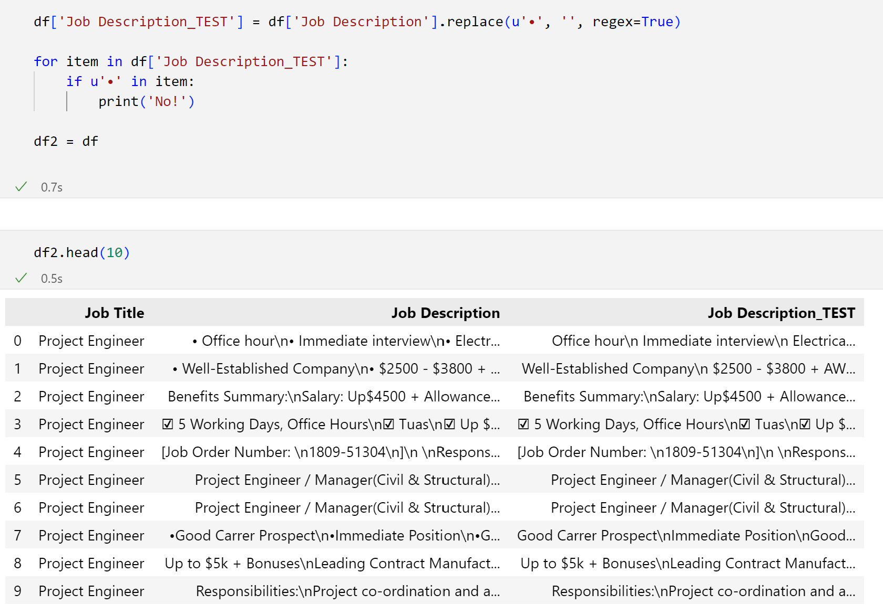
Sample cleaning, removing of bullet point.

Slide 10

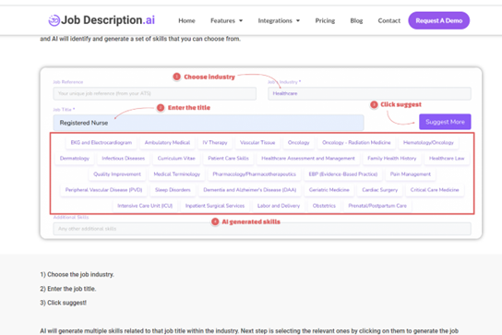


Database compilation

Slide 11
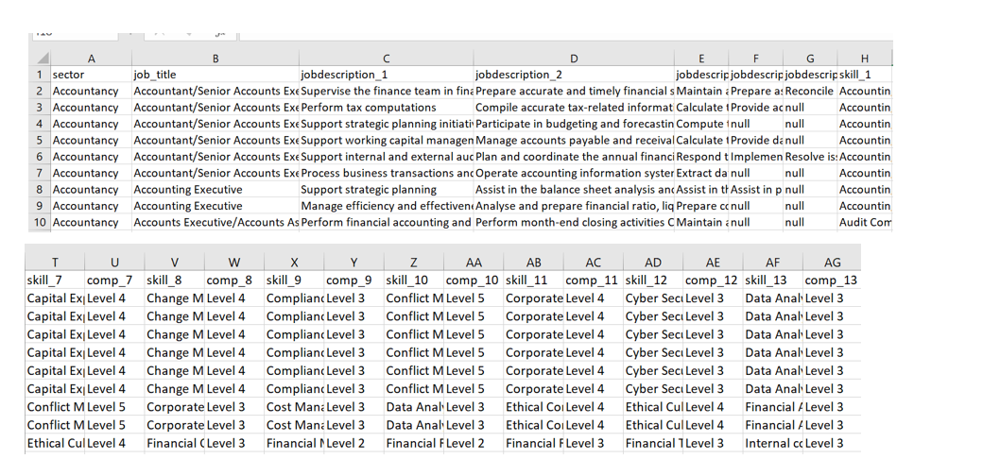
Database compilation

Slide 12
Questions
Who are our clients, Recruiters or Job-Seekers?
How to effectively clean the data sets.
How can we accurately define the Hot-Words/Keywords?
How do we use keywords to generate paragraph texts?
What current industry standard models that you would recommend?
Vectorizations, POS Tagging, Word2Vec, Glove Models, Re-Train models, Transform Models, MiniBert, Generate Inference, Send2Vec, NER, Feature Extraction
How do you train an entire csv file and not part of text.
Shi Wei's qn about highest count sentences by job title....

